Slide 1

WELCOME
COHORT 5
7th Sept – 3rd Dec 2026
Suite 6-6-7, Level 6, Menara MAA

Slide 2


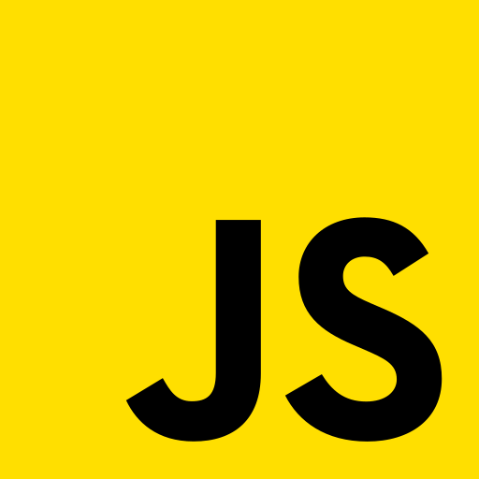
Languages for Building Web Application
Build a web page structure
Add stylings to web page
Add dynamic behavior/interactivity
to web page

Slide 3
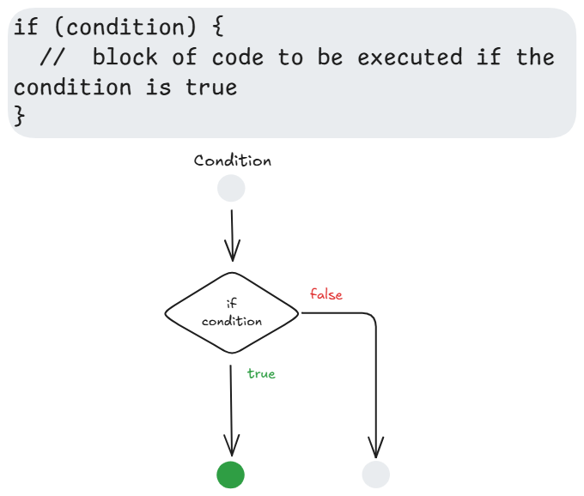
Control-flow: if-else statements
The if...else statement executes a statement if a specified condition is true.

Slide 4
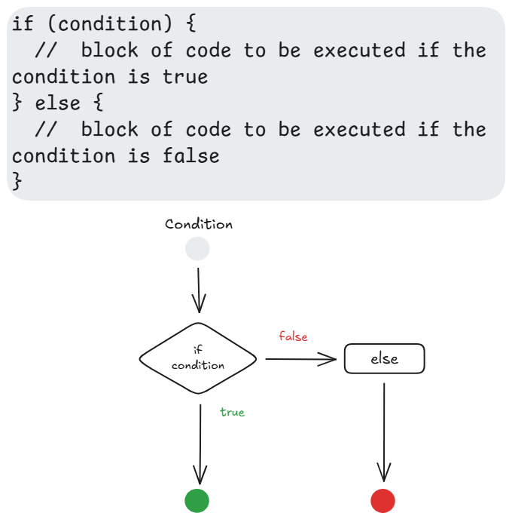
Control-flow: if-else statements
The if...else statement executes a statement if a specified condition is true.

Slide 5
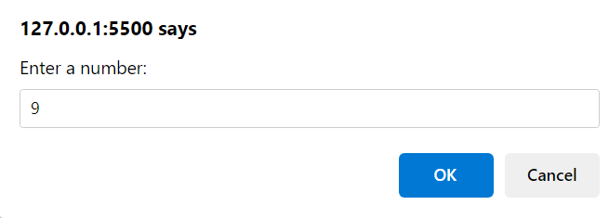
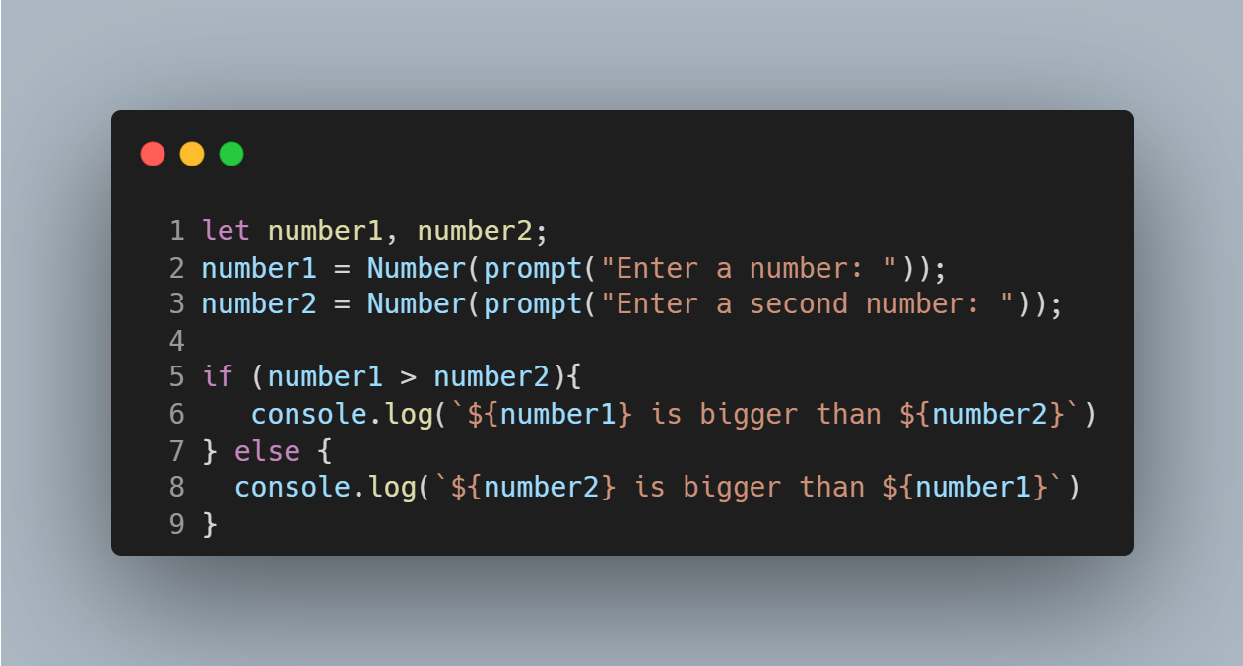
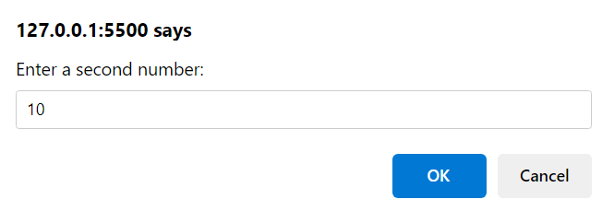

Control-flow: if-else statements
The statements in each of the if-else blocks are indented
Notes:
${} is called template literal syntax or string interpolation. It's a way to embed expressions (variables, calculations, function calls) directly inside strings.
Must be inside backticks (`)
The ${} acts like a placeholder that gets replaced with the value

Slide 6
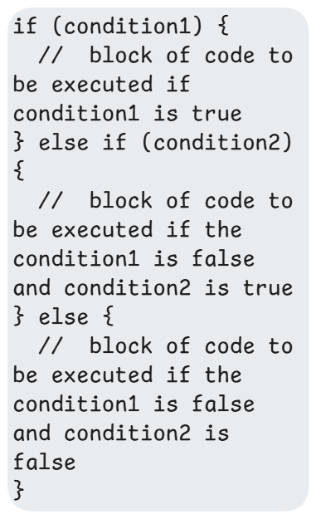
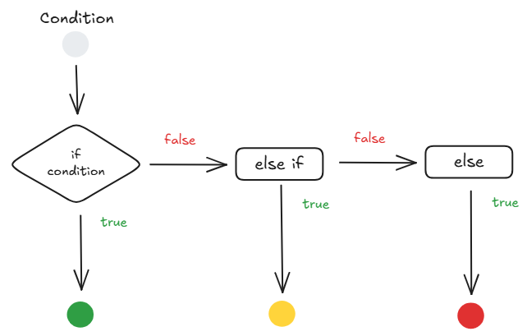
Control-flow: if-else-if statements​
The if else if statements are used in a situation where a user has to decide among multiple options.

Slide 7
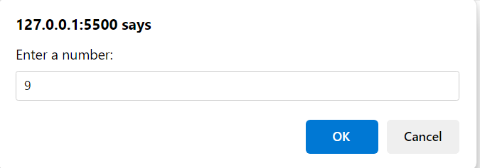
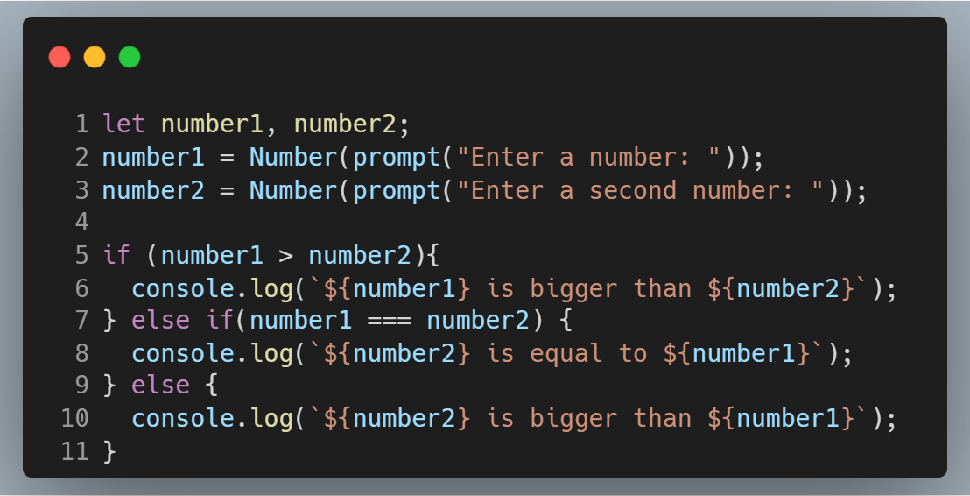
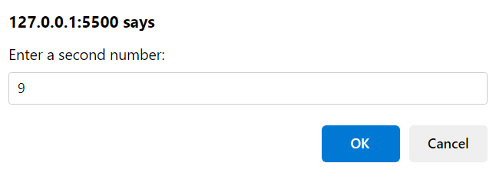
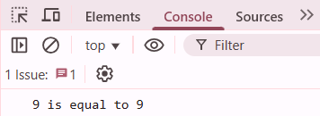
Control-flow: if-else-if statements​

Slide 8
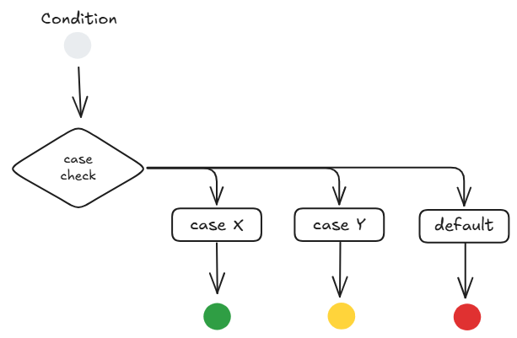
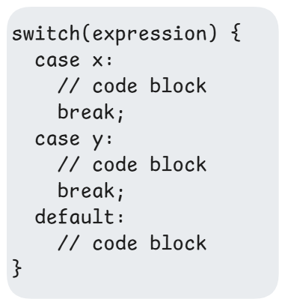
Control-flow: switch statements
The switch statement is used to perform different actions based on different conditions.
It is often used as an alternative to multiple if-else if statements.

Slide 9
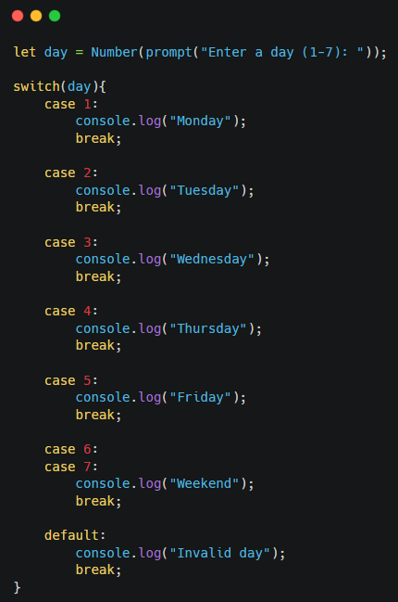
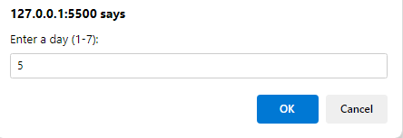

Control-flow: switch (Hands-on)
Switch example – input is number
Notes:
What happens if we do not put break?

Slide 10
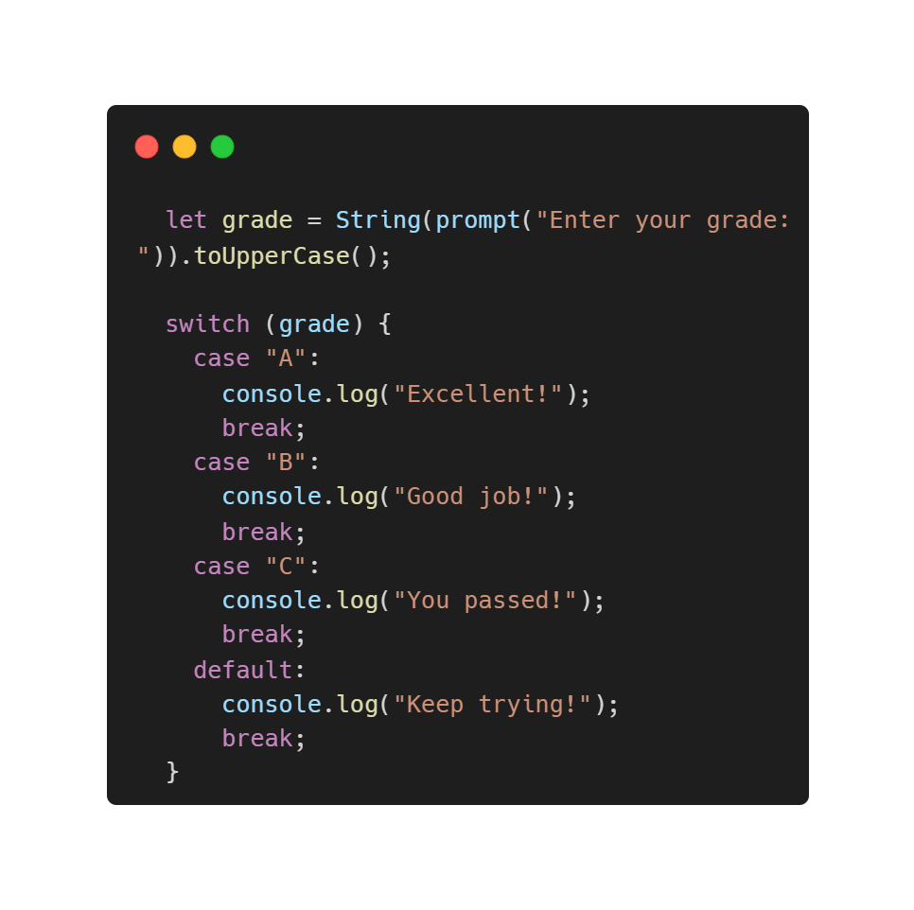
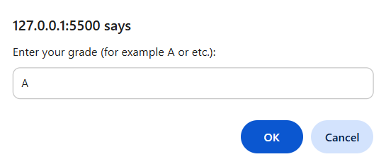
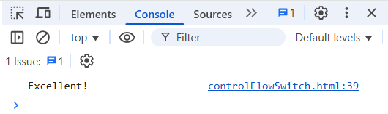
Control-flow: switch (Hands-on)
Switch example – input is string
Notes:
What happens if we do not put break?

Slide 11
Loops and Iterations
for loop
while loop
do … while loop

Slide 12
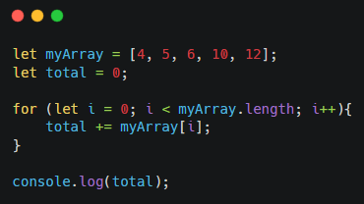

Counter-controlled loops
(for loops)​
1
First statement – usually initialize a counter value
2
Second statement – loop condition
1
2
3
3
Third statement – usually
increment or decrement a counter
Notes:
let i = 0: Start counter at 0 (first array index)
i < myArray.length: Continue while i is less than array length (5)
i++: Increment i by 1 after each iteration
myArray[i]: Access array element at index i
total +=: Add the current element to total (same as total = total + myArray[i])

Slide 13
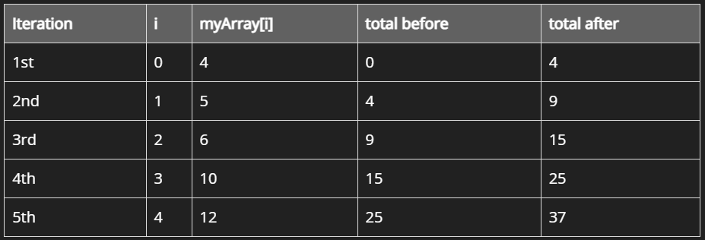
Counter-controlled loops
(for loops)​
Visual representation of for loops execution
for (let i = 0; i < myArray.length; i++)
To use index increament of 2 for example, use i += 2

Slide 14
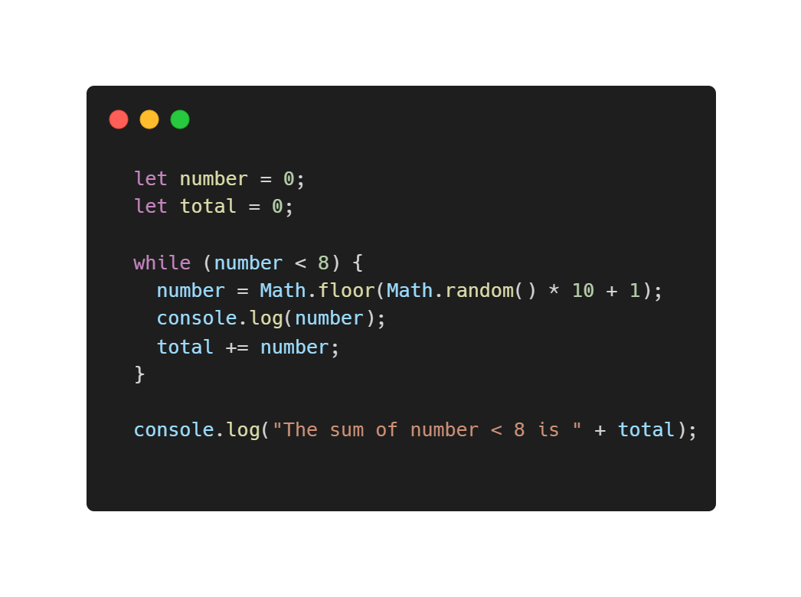
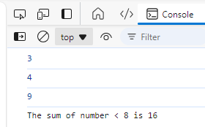
An example of sentinel-control loops​ - while loop
Sentinel value
An expression to generate random number between 1-10
Notes:
When to use sentinel while loop – When might no need to execute (0 or more times)

Slide 15
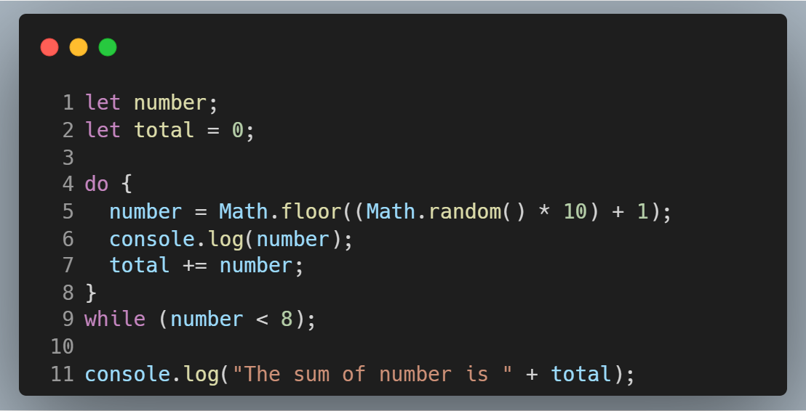
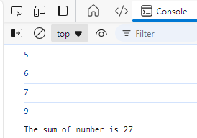
An example of sentinel-control loops​ - do-while loop
Notes:
When to use do while loop – If need guaranteed execution (at least 1 or more times)

Slide 16
Arithmetic Operators
Operator | Description
+ | Addition
- | Subtraction
* | Multiplication
** | Exponentiation
/ | Division
% | Modulus (Remainder)

Slide 17
Comparison Operators
Operator | Description
== | Equal to
=== | Equal value and equal type (strict comparison)
!= | Not equal
!== | Not equal value or not equal type (strict comparison)
> | Greater than
< | Less than
>= | Greater than or equal to
<= | Less than or equal to

Slide 18
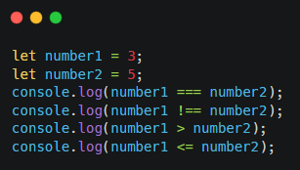
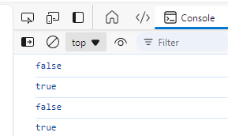
Comparison Operators
Comparison operators

Slide 19
Logical Operators
Operator | Description
&& | and
|| | or
! | not

Slide 20
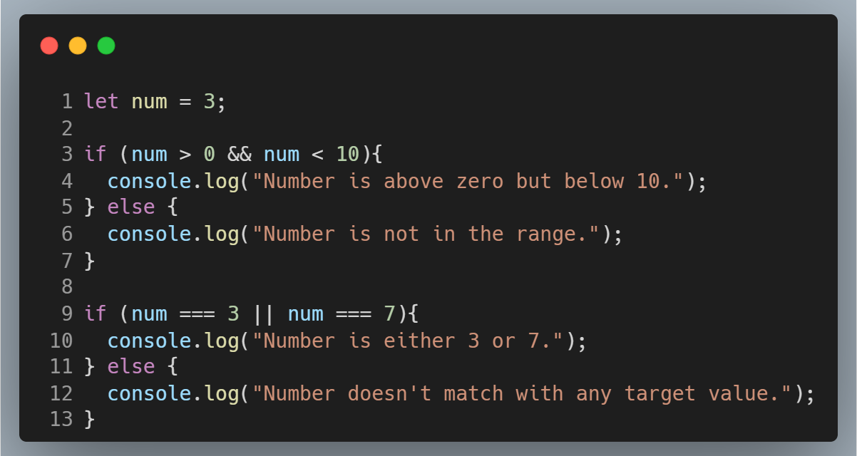
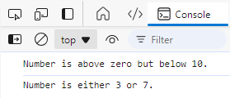
Logical Operators

Slide 21
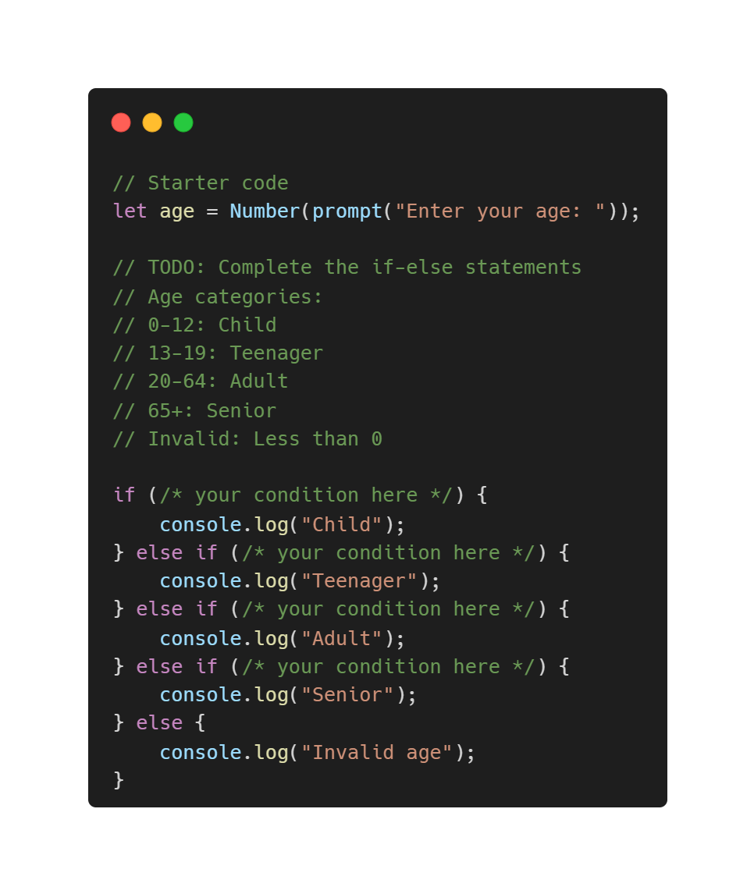
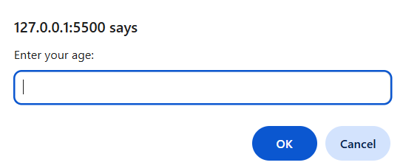
Coding Exercise 1
Age Category Classifier (if-else)
Instructions: Create a simple program that asks for a person's age and categorizes them.

Slide 22
Programming Principles
DRY - Don’t Repeat Yourself
KISS - Keep It Simple, S—
Nothing is particularly hard if you divide it into small jobs.
– Henry Ford.

Slide 23
Function
Functions are self-contained blocks of code that perform specific tasks.
They are essential for structuring and organizing your code, promoting reusability, and improving code readability.

Slide 24
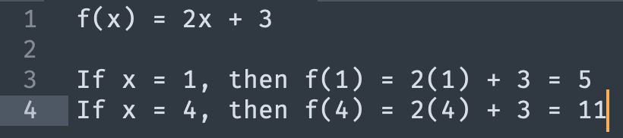
f(x)
f(x) is mathematical notation that represents a function.
f = the name of the function
x = the input variable (also called the independent variable)
f(x) = the output value (also called the dependent variable)

Slide 25
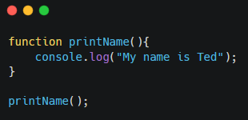

Function
1
Function name: The name you give to the function.
1
2
2
function body: The code that executes when the function is called

Slide 26
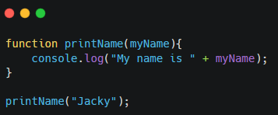
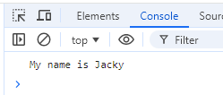
Function Parameter
Variables that represent the values passed to the function.
Parameter

Slide 27
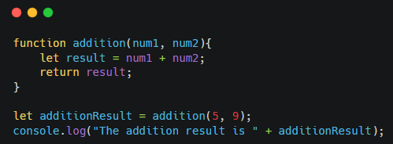

Function Return Statement
A function can return a value to the calling code.

Slide 28
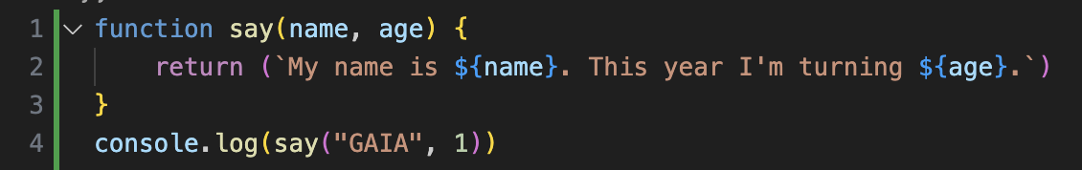
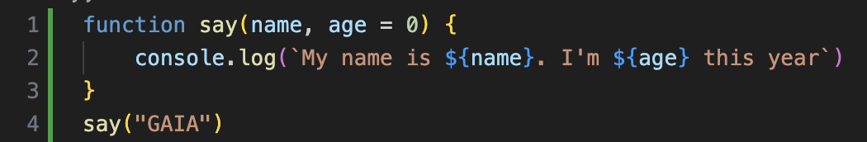
Function With Default Value
Function with default value. Notice how default value also means the input is optional

Slide 29
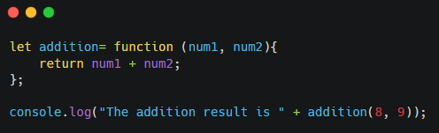

Anonymous Function
An anonymous function in JavaScript is a function that doesn't have a specific name.

Slide 30
Arrow Function
An arrow function is essentially an anonymous function with a shorter syntax.
They are often assigned to variables, making them reusable.
Arrow functions are often used as callbacks in asynchronous operations due to their concise syntax.

Slide 31
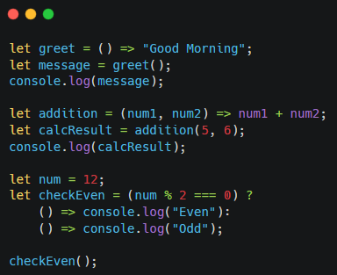
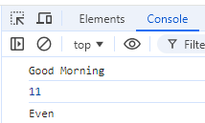
Arrow Function

Slide 32
Coding Exercise 2
Scenario - You have a team member profile application and need to add functions to extract and display specific information about each member as following:
Full Name Display:
Create a function to display member full name.
Full Name Vowel Count:
Create a function that used to count vowel in member full name.
Food Lover Check:
Create a function to check if member is food lover (which has more than favourite food).
Pet Lover Check:
Create a function to check whether member is a pet keeper (has more than one pet).
Notes:
let teamMember1 = {
firstName: "Alice",
lastName: "Johnson",
hobbies: ["Reading", "Hiking", "Coding"],
favoriteFoods: ["Pizza", "Sushi", "Chocolate"],
pets: ["Dog", "Cat"]
};
let teamMember2 = {
firstName: "Bob",
lastName: "Smith",
hobbies: ["Gaming", "Photography"],
favoriteFoods: ["Burgers", "Pasta"],
pets: []
};
let teamMember3 = {
firstName: "Charlie",
lastName: "Brown",
hobbies: ["Drawing", "Music", "Cooking"],
favoriteFoods: ["Tacos", "Ice Cream"],
pets: ["Parrot"]
};
function getFullName(member) {
if (!member || !member.firstName || !member.lastName) {
return "Invalid member data";
}
return `${member.firstName} ${member.lastName}`;
}
function countFullNameVowels(member) {
const fullName = getFullName(member).toLowerCase();
const vowels = "aeiou";
let vowelCount = 0;
for (let i = 0; i < fullName.length; i++) {
if (vowels.includes(fullName[i])) {
vowelCount++;
}
}
return vowelCount;
}
function isFoodLover(member) {
if (!member || !Array.isArray(member.favoriteFoods)) {
return false;
}
return member.favoriteFoods.length > 1;
}
function isPetKeeper(member) {
if (!member || !Array.isArray(member.pets)) {
return false;
}
return member.pets.length > 1;
}
console.log("--- Team Member 1: Alice Johnson ---");
console.log("Full Name:", getFullName(teamMember1));
console.log("Vowel Count:", countFullNameVowels(teamMember1));
console.log("Is Food Lover (>1 food):", isFoodLover(teamMember1));
console.log("Is Pet Keeper (>1 pet):", isPetKeeper(teamMember1));

